Slide 1
Static Vs Dynamic Routing

Slide 2
Dynamic Routing
routing that takes place as your app is rendering, not in a configuration or convention outside of a running app. That means almost everything is a component in React Router.

Slide 3
Static Routing
static routing is that it allows for inspection and matching of routes before rendering. Hence it proves useful especially on server side. The react router team is also working on a solution called react-router-config, quoting from which:

Slide 4
CLIENT SIDE ROUTING
With a single page applications, when a user clicks on an internal link within your application, the goal would be to see a change in the url bar to show that there is an update happening to the page without a full page refresh. With a SPA, we don’t require multiple pages to load, just the original request with our initial HTML, CSS and JS files from the Server. Because of this, client-side routing is used to create that SPA experience while making the routes more uniform and organized for our users to see. The routing is to make our users have a better experience overall because they are able to pinpoint with the route in the url bar where they are at in the application, all without us needing to make multiple server requests.

Slide 5
React Router is a collection of navigational components that compose declaratively with your application.
In short, with static routes, we establish the routes we are looking to hit up front and then call the routes when needed. This would be implemented by having a separate javascript file called routes.js that would contain all of the possible routes that your application would need to hit.
Now every time a user clicks on a link, this will call on that routes.js file you created and look for the endpoint that matches the link that was clicked on. This creates an extra step after the link is clicked because now the server is called to respond to this request. The problem with this is that these requests take time to be resolved. This new request time can vary depending on the strength of the connection making this call to the server file.

Slide 6
With dynamic routing, routes are updated as your app renders. In other words, the route that is seen in the URL bar is updating for the client to see, however, there is no communication with any server for that to happen. React Router to its core is a component. This means adding router functionality to your React app is done the same way you would add any other functionality to your React app.

Slide 7
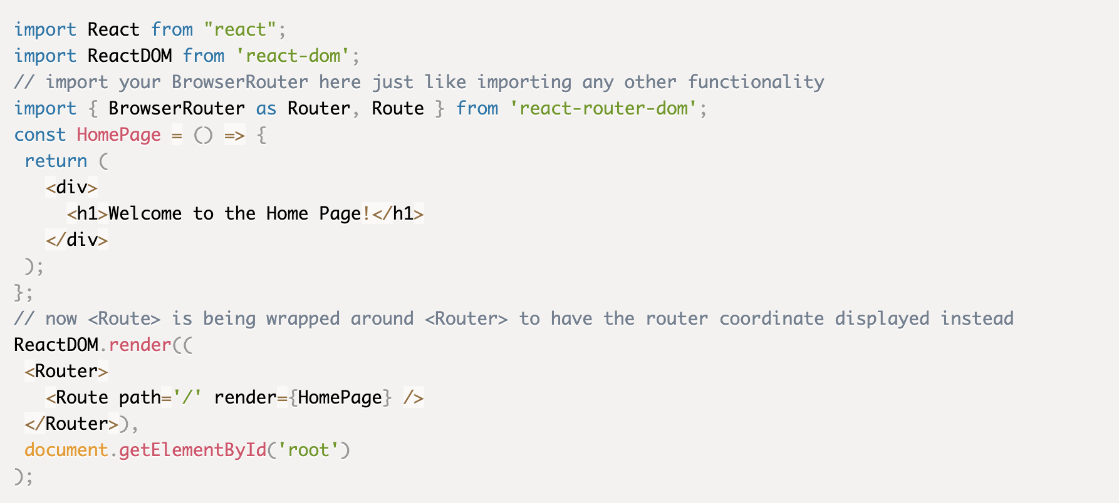

Slide 8
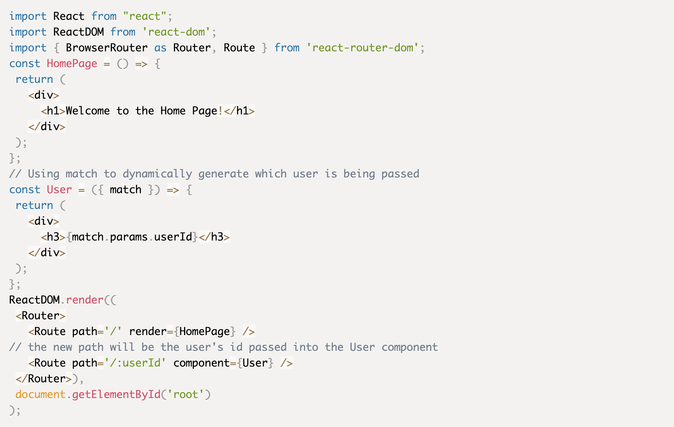
Dynamic routing with ReactRouter

